Slide 1
Electric School Bus Network
National Forum
February 12, 2025

Slide 2
Forum Agenda
01.
Intro to the Electric School Bus Network
February 12, 2025
02.
Industry Updates
03.
Q&A
04.
Summary and Closing

Slide 3
Electric School Bus Network
The Electric School Bus Network accelerates nationwide school bus fleet electrification through peer-to-peer networking and dialogue-driven forum meetings for school districts, advocacy organizations, government organizations, and industry representatives. The ESB Network provides access to educational tools, resources, and subject matter experts to help support the electric school bus fleet transition.

Slide 4
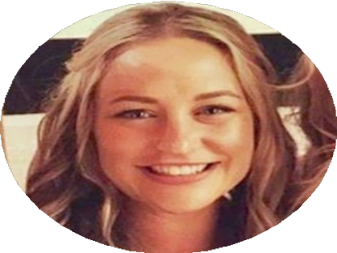
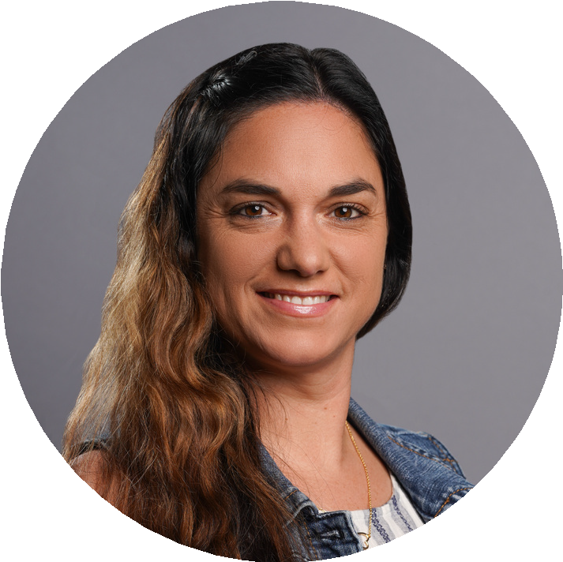
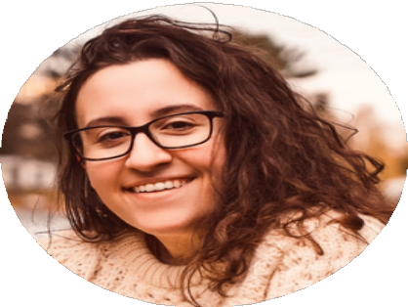
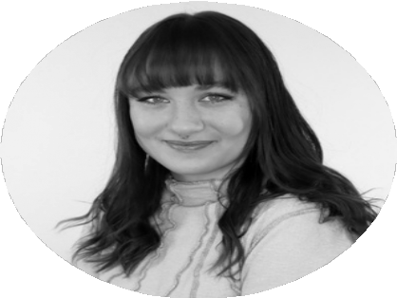
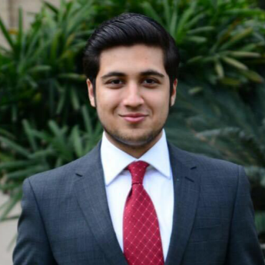
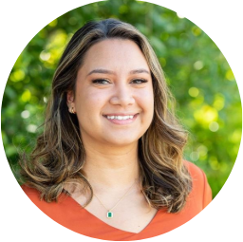
Meet the ESB Team
Rachel Chard
Deputy Director
Michelle Hanson
Program Manager
Ian Fried
Lead Project Manager
Alise Crippen
Lead Project Manager
Chrystal Ales
Project Manager
Katelyn Tomaszewski
Project Manager
Skyler Potocek
Project Manager
Sarah Stalcup-Jones
Project Manager
Ibraheem Ameer
Project Manager
Liza Walsh
Project Manager
Paige Seles
Project Manager
Alberto Santos-Davidson
Project Manager
Emily Gasca
Project Manager

Slide 5
Electric School Bus Network Forum Meetings
Forum meetings are not webinars - they are ongoing discussions where participation is encouraged
Goal: Ease the transition to electrify school bus fleets nationwide
Facilitate conversations
Provide up-to-date information
Independent/Third Party Partner

Slide 6
Ice Breaker: How is the cold winter weather impacting your fleet operations?

Slide 7
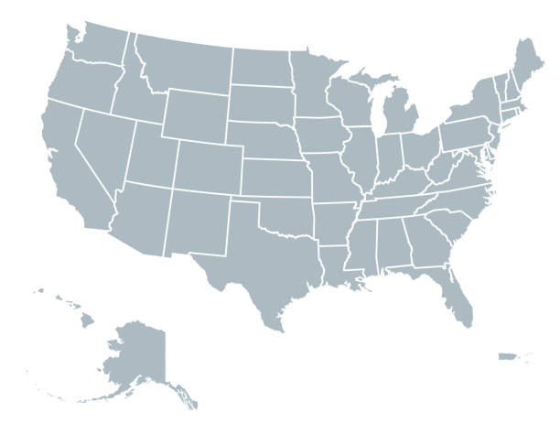
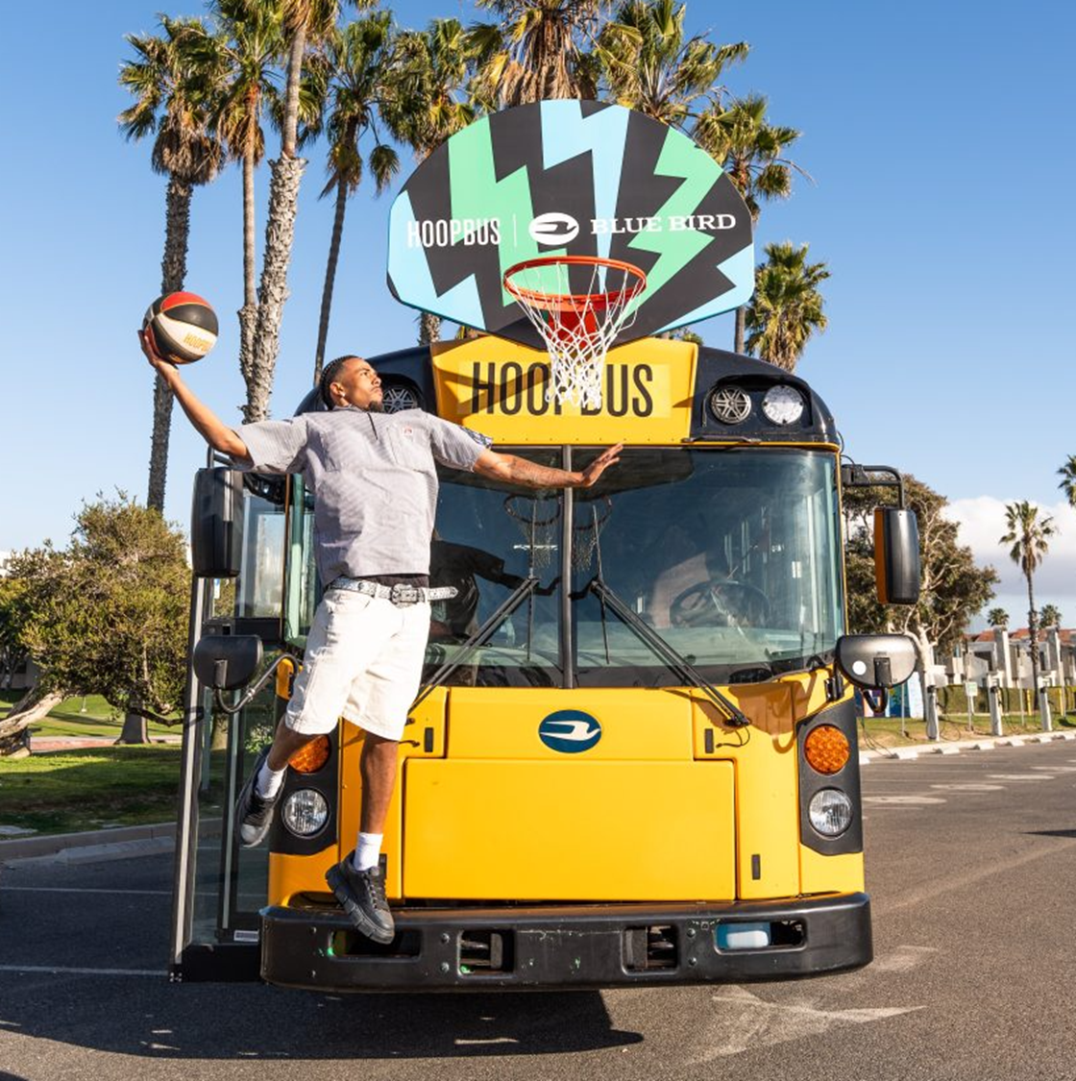
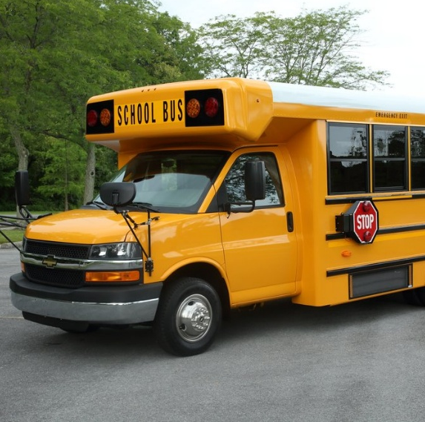
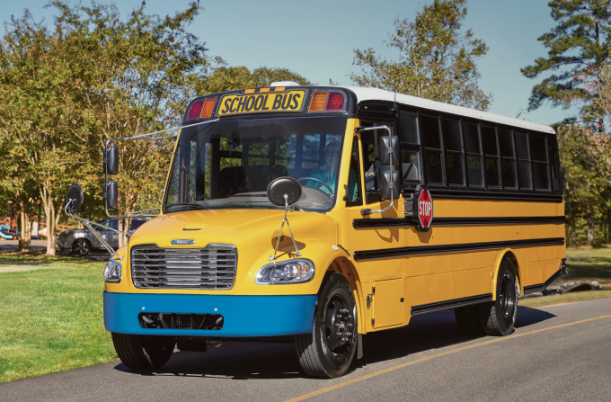

Slide 8
Industry Updates

Slide 9
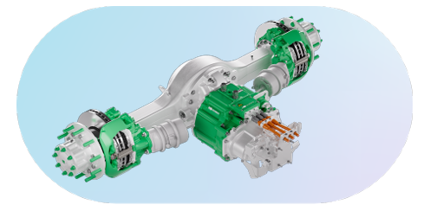
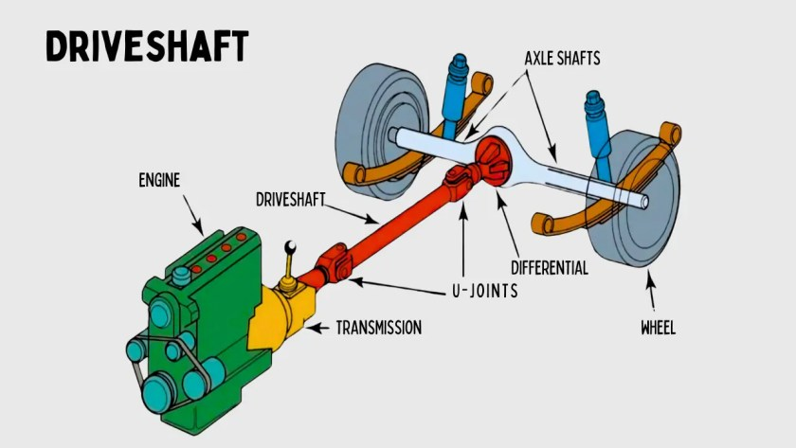
New Thomas Built Jouley, Gen 2, Announced
Thomas Built Buses Saf-T-Liner C2 Jouley Gen 2
With an Accelera 14Xe eAxle by Cummins to enhance efficiency
800-volt Proterra battery
Notes:
https://thomasbuiltbuses.com/school-buses/saf-t-liner-c2-jouley-gen-2/#videoplay/0/
High Point, NC

Slide 10
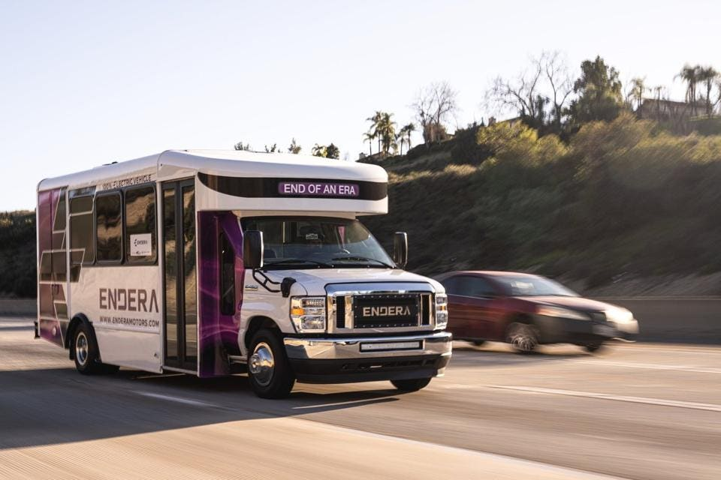
Endera Scores Major Investments
Announced February 11th
Producing class 4 electric shuttles and school buses in the U.S.
Expect to expand their Ohio factory's production capacity and workforce
Notes:
https://thomasbuiltbuses.com/school-buses/saf-t-liner-c2-jouley-gen-2/#videoplay/0/
High Point, NC

Slide 11
State Funding

Slide 12
Maryland Electric School Bus Grant Program
Update announced January 22
$17 million for grants to purchase and lease electric school buses to serve Maryland public school students in 2025
Grants will cover up to 120% of the incremental cost of eligible vehicles, with additional funding for charging infrastructure (cap of 30% of the total project funding request), and other associated costs.
Applications are due March 17th, 2025 at 3 PM EST
Notes:
https://dep.nj.gov/newsrel/25_p007/

Slide 13
Michigan SEC 74 Clean School Bus Grant Round #3
Open Nov 4, 2024 – May 2, 2025
$125 million grant program
Diesel replacement program (scrappage required)
Up to 70% of cost of ESB, charging station and infrastructure
High-need districts eligible for up to 90%
Notes:
https://dep.nj.gov/newsrel/25_p007/

Slide 14
New Jersey RGGI
Announced February 7
$35M in RGGI cap-and-trade funds
Replacing diesel shuttles, transit, school bus, and truck fleets
Electric School Bus Grant Program TBA this spring (per press release)
Notes:
https://dep.nj.gov/newsrel/25_p007/

Slide 15
New York School Bus Incentive Program
The New York State Legislature mandates that all school buses purchased after 2027 must be electric
Provides $500 million to support the transition to ESBs
Funding for ESBs and charging infrastructure
Awarded on first-come, first-served basis
Bonus voucher funding available for priority districts, ICE school bus scrappage, V2G add-on, wheelchair add-ons and fleets that complete approved fleet transition plans
Notes:
https://dep.nj.gov/newsrel/25_p007/

Slide 16
Texas Volkswagen Environmental Mitigation Program
Grants to replace or repower eligible diesel-fueled vehicles with all-electric models (including support for necessary charging infrastructure)
Government-owned projects may receive up to 100% of eligible costs
Non-government-owned projects eligible for up to 75% of eligible costs
Grants awarded on a first-come, first-served basis. Applications due August 31, 2025 at 5:00 p.m. CST unless the program is closed early due to demand.
Notes:
https://dep.nj.gov/newsrel/25_p007/

Slide 17
Utah Clean Fleet Program
Diesel replacement program (scrappage required)
Reimbursement of up to 45% of the cost of new all-electric school bus and charging equipment (including installation)
Buses must operate in the following counties to be eligible: Box Elder, Cache, Davis, Duchesne, Salt Lake, Tooele, Uintah, Utah, and Weber
Notes:
https://dep.nj.gov/newsrel/25_p007/

Slide 18
Wyoming DEQ 2025 School Bus Program
Announced January 16
Providing $1M+
Diesel replacement program (scrappage required)
Reimbursement for up to 25% of the final purchase price of the vehicle
Notes:
https://deq.wyoming.gov/2025/01/deq-2025-school-bus-replacement-program-is-now-open/

Slide 19
Other Updates

Slide 20
New Mexico & GreenPower MOU
Announced January 30
Signed MOU to appropriate $5M for pilot program and bus service facility
The state will pursue additional $15M for purchasing additional school buses
Beginning in 2025-2026 timeframe
Notes:
https://stnonline.com/news/greenpower-new-mexico-to-partner-on-electric-school-bus-pilot-program/

Slide 21
New Mexico Cont.
Feb 6 bill passed through first committee to give NM school districts choice of replacing diesel school buses with zero emission alternatives
Would require Public Education Department to provide funding
Notes:
https://www.yahoo.com/news/bill-making-electric-school-buses-231117385.html?guccounter=1&guce_referrer=aHR0cHM6Ly93d3cuZ29vZ2xlLmNvbS8&guce_referrer_sig=AQAAACj5nexXZboBxyBUhjHLGO7pltOOdt_G4TZYeJIYhG2ACN2NsGt0pIXWQRmC5YiENFanig7tf1tfoQoIYlqzQuy3NdXFAHGLrwNR1hOoq0s_XxBH4FS5IsTEvL2GoSjW2RsCR9hTiK3o8yA0zJQtQWh75QMbaPvZy_sLmAwnKA0G

Slide 22
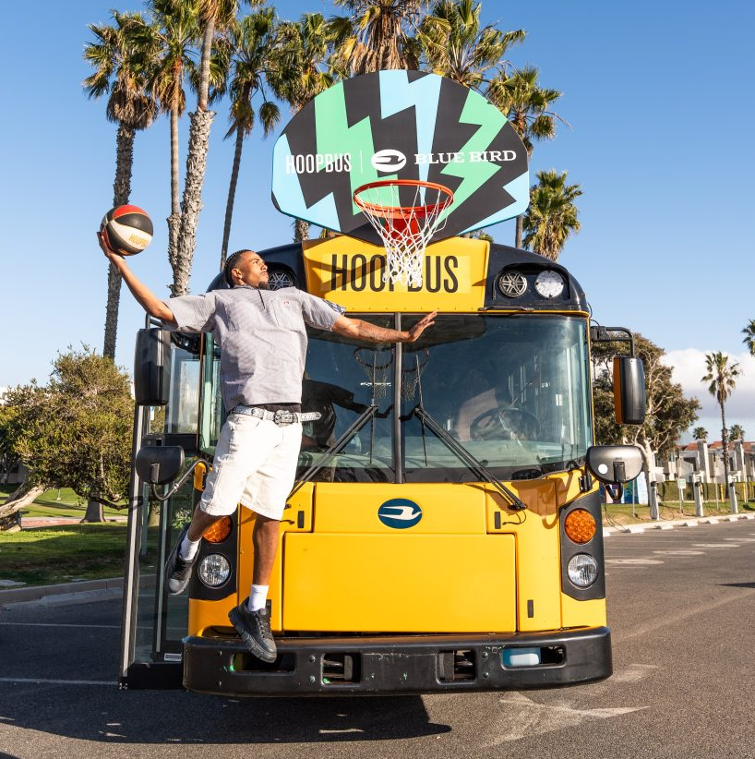
Other News
Blue Bird donates ESB to Hoop Bus
501©(3) non-profit dedicated to youth programming and engagement
Bus equipped as mobile baske
Notes:
https://www.blue-bird.com/blue-bird-donates-electric-school-bus-to-hoop-bus/
https://whnt.com/business/press-releases/ein-presswire/783811266/unique-electric-solutions-secures-executive-order-from-california-air-resources-board-for-school-bus-electrification/

Slide 23
Questions?

Slide 24
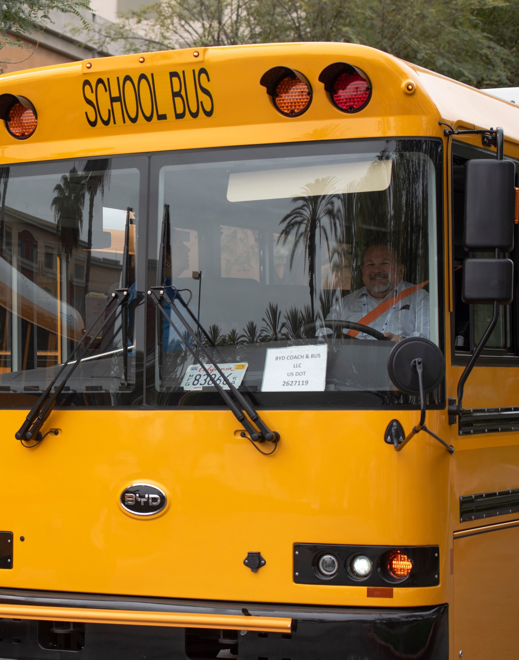
Thank You for Participating
A follow-up email will be sent Friday, February 14 with the following:
Recording of the meeting
Copy of the slide deck
The next ESB Network Newsletter will be sent on Tuesday, March 11
The next National Forum will be April 9, 2025, from 1:00–2:00 p.m. ET
Please email schoolbusteam@calstart.org with questions for our team

Slide 25
www.electricschoolbusnetwork.org

